Slide 1


Slide 2


Slide 3
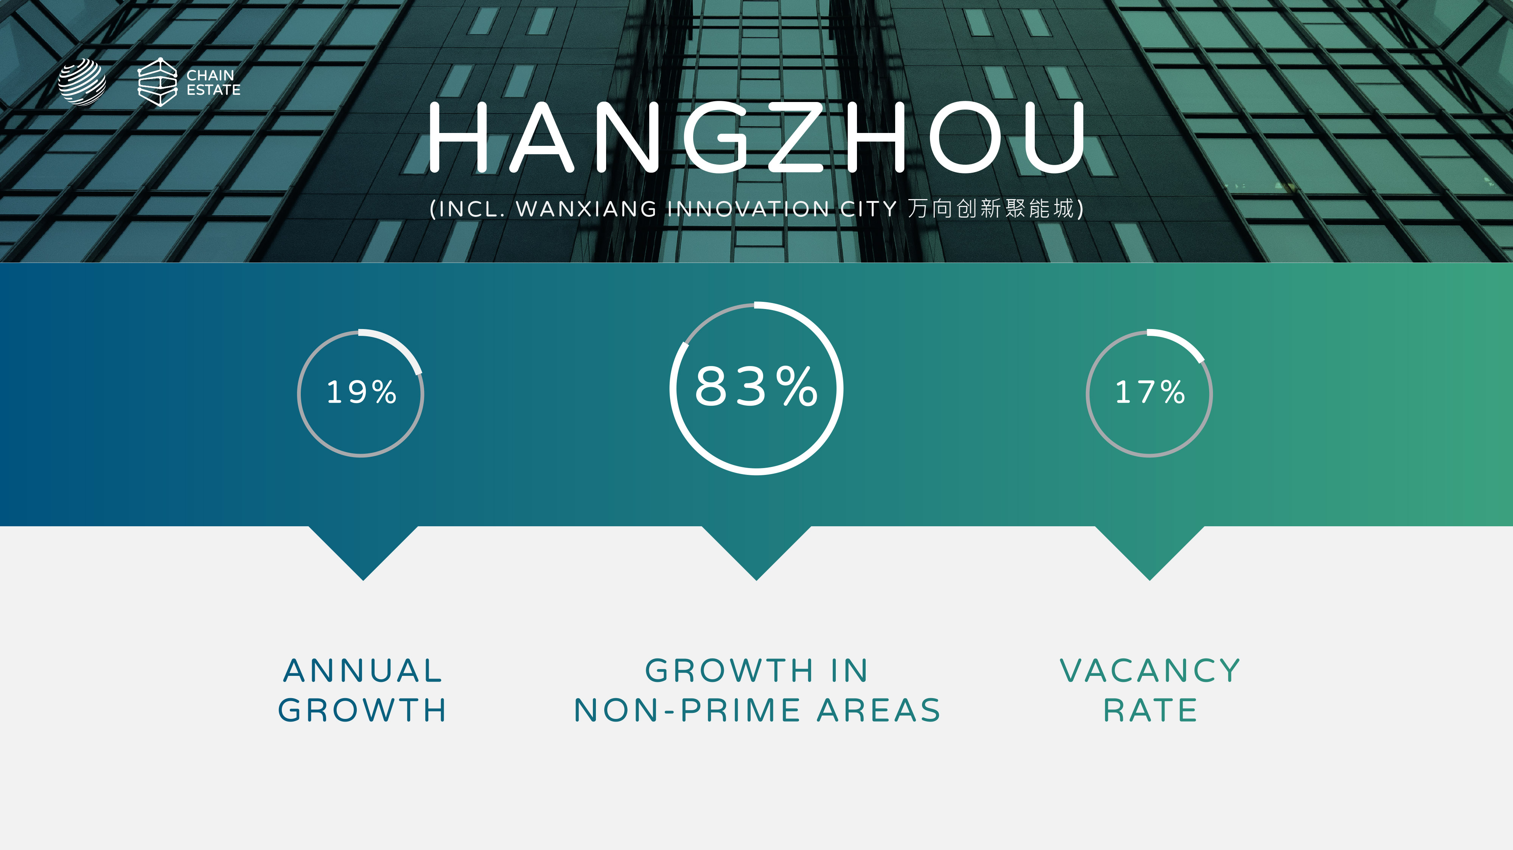

Slide 4
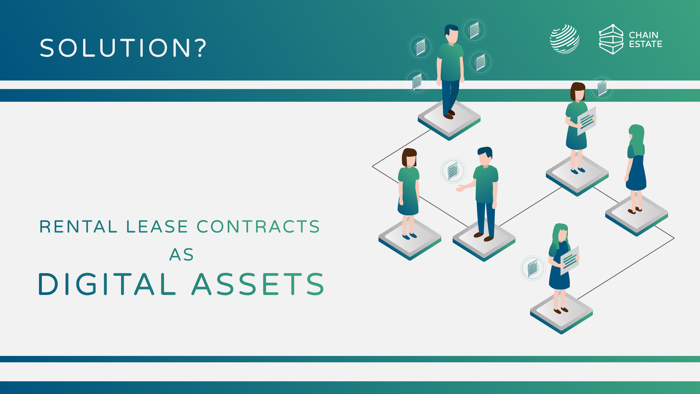

Slide 5
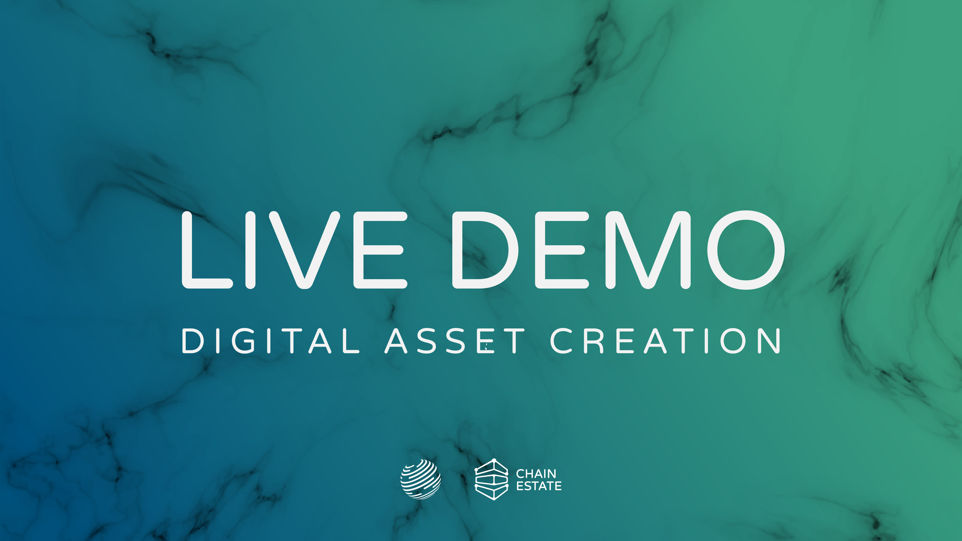
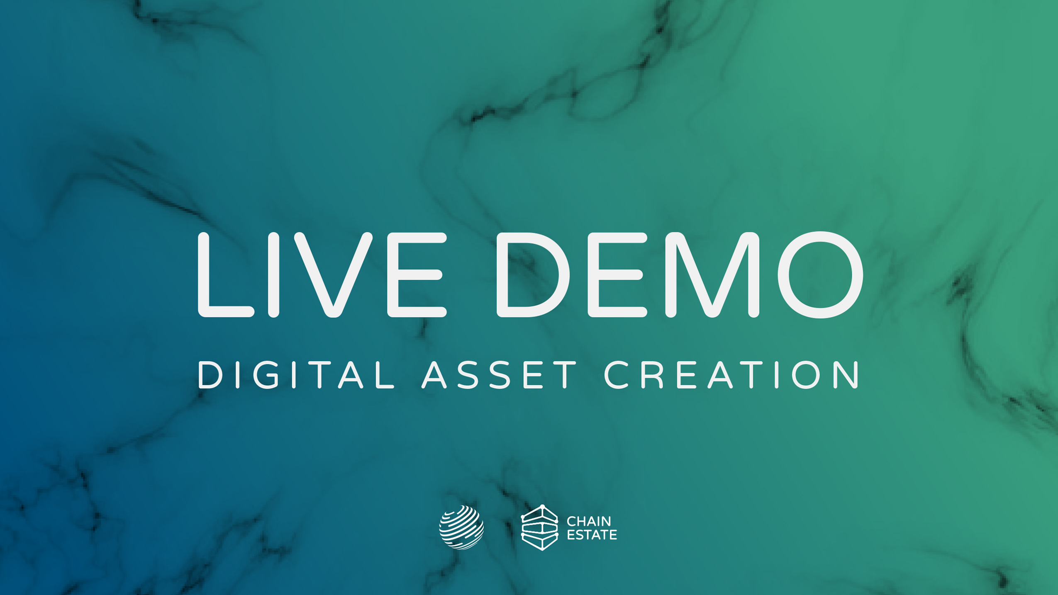

Slide 6
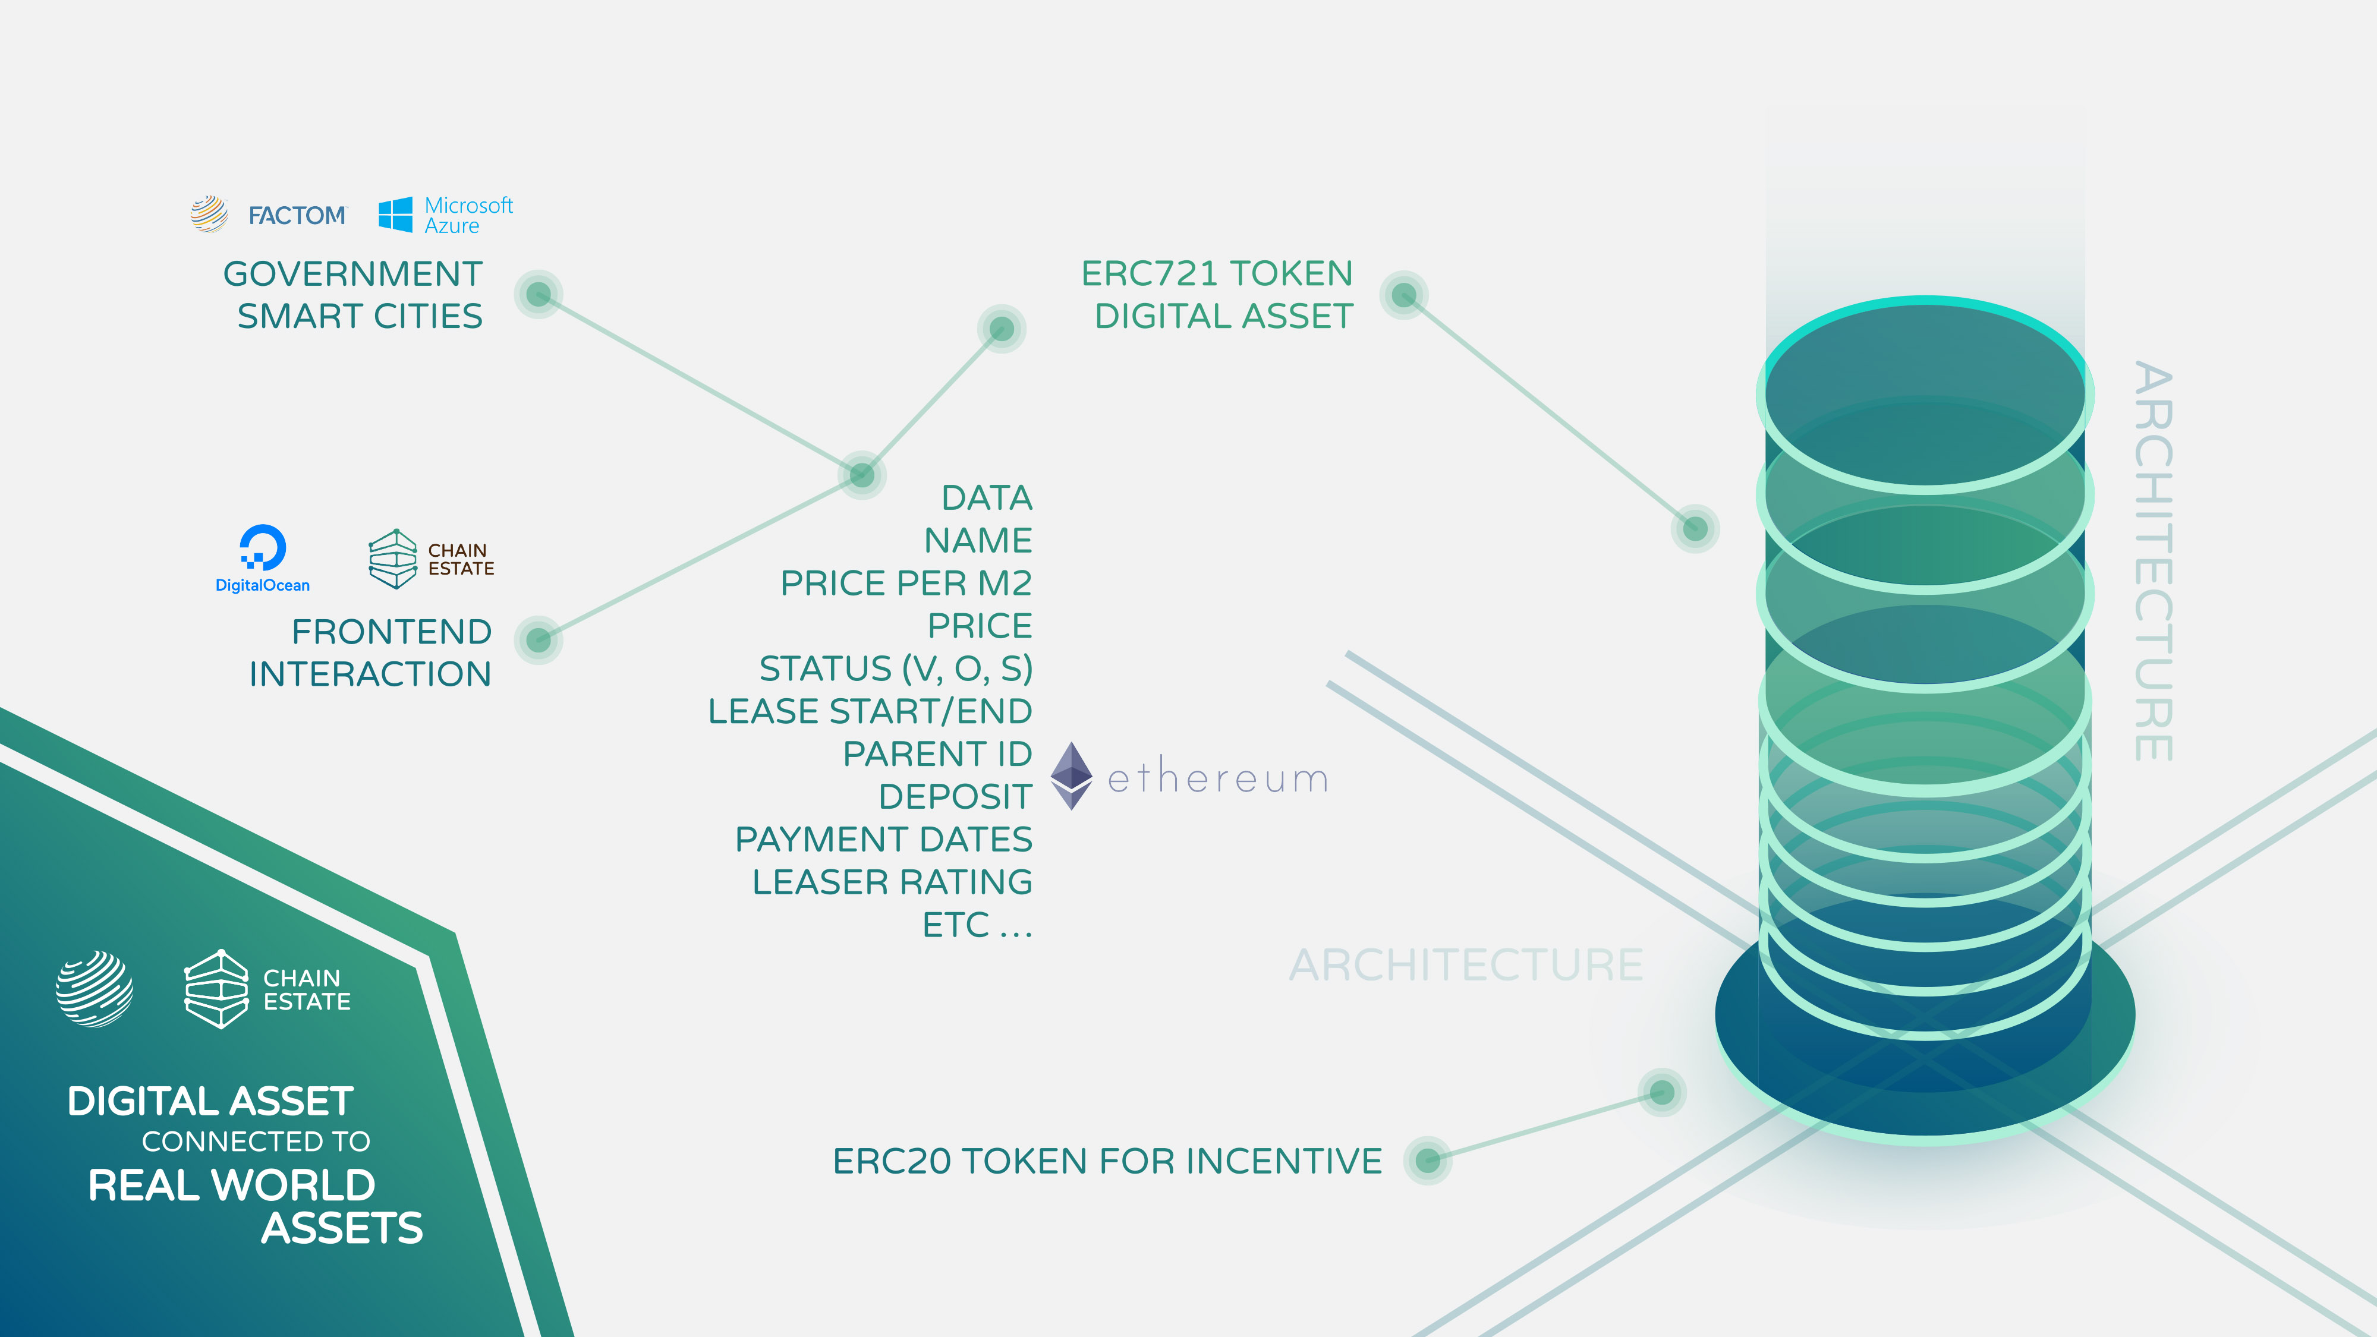
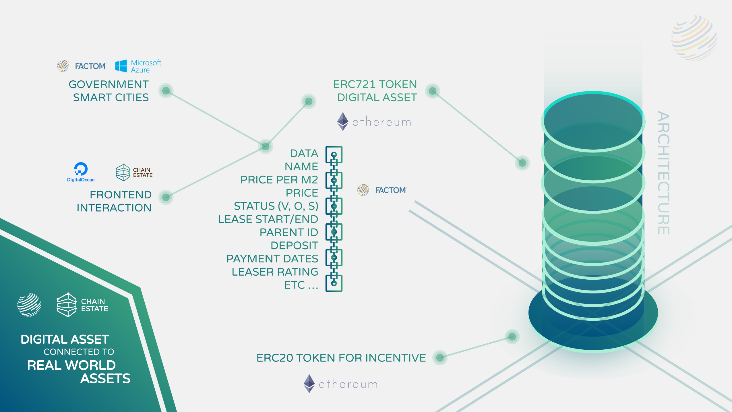

Slide 7
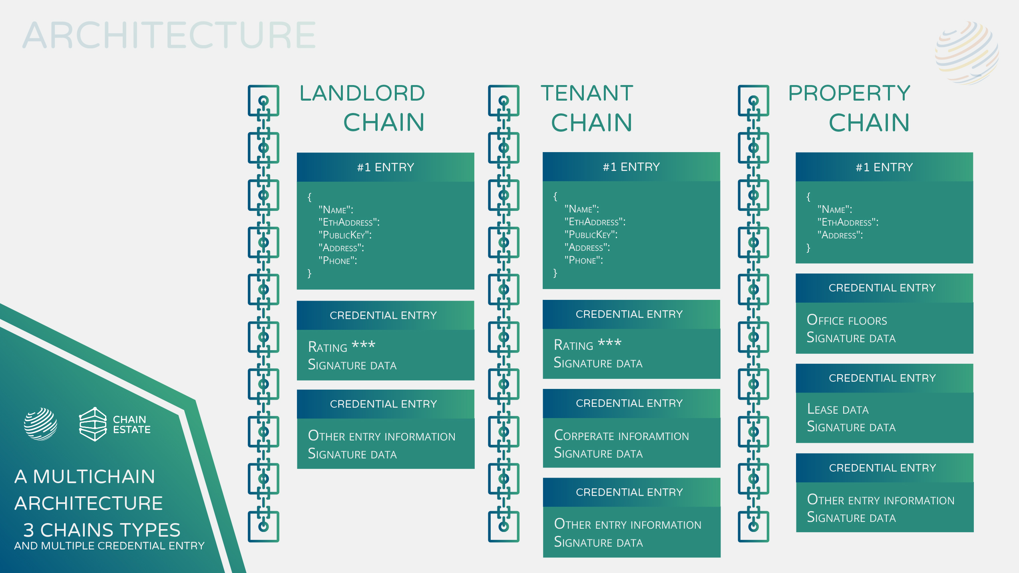

Slide 8


Notes:
We combine the Mutable state of ETH to track ownership of the space token … With the faster and cheaper storage of Factom. We also use Factom to track and store data about the Property, Leaser and Landlord. It could be possible to create smart contracts to

Slide 9
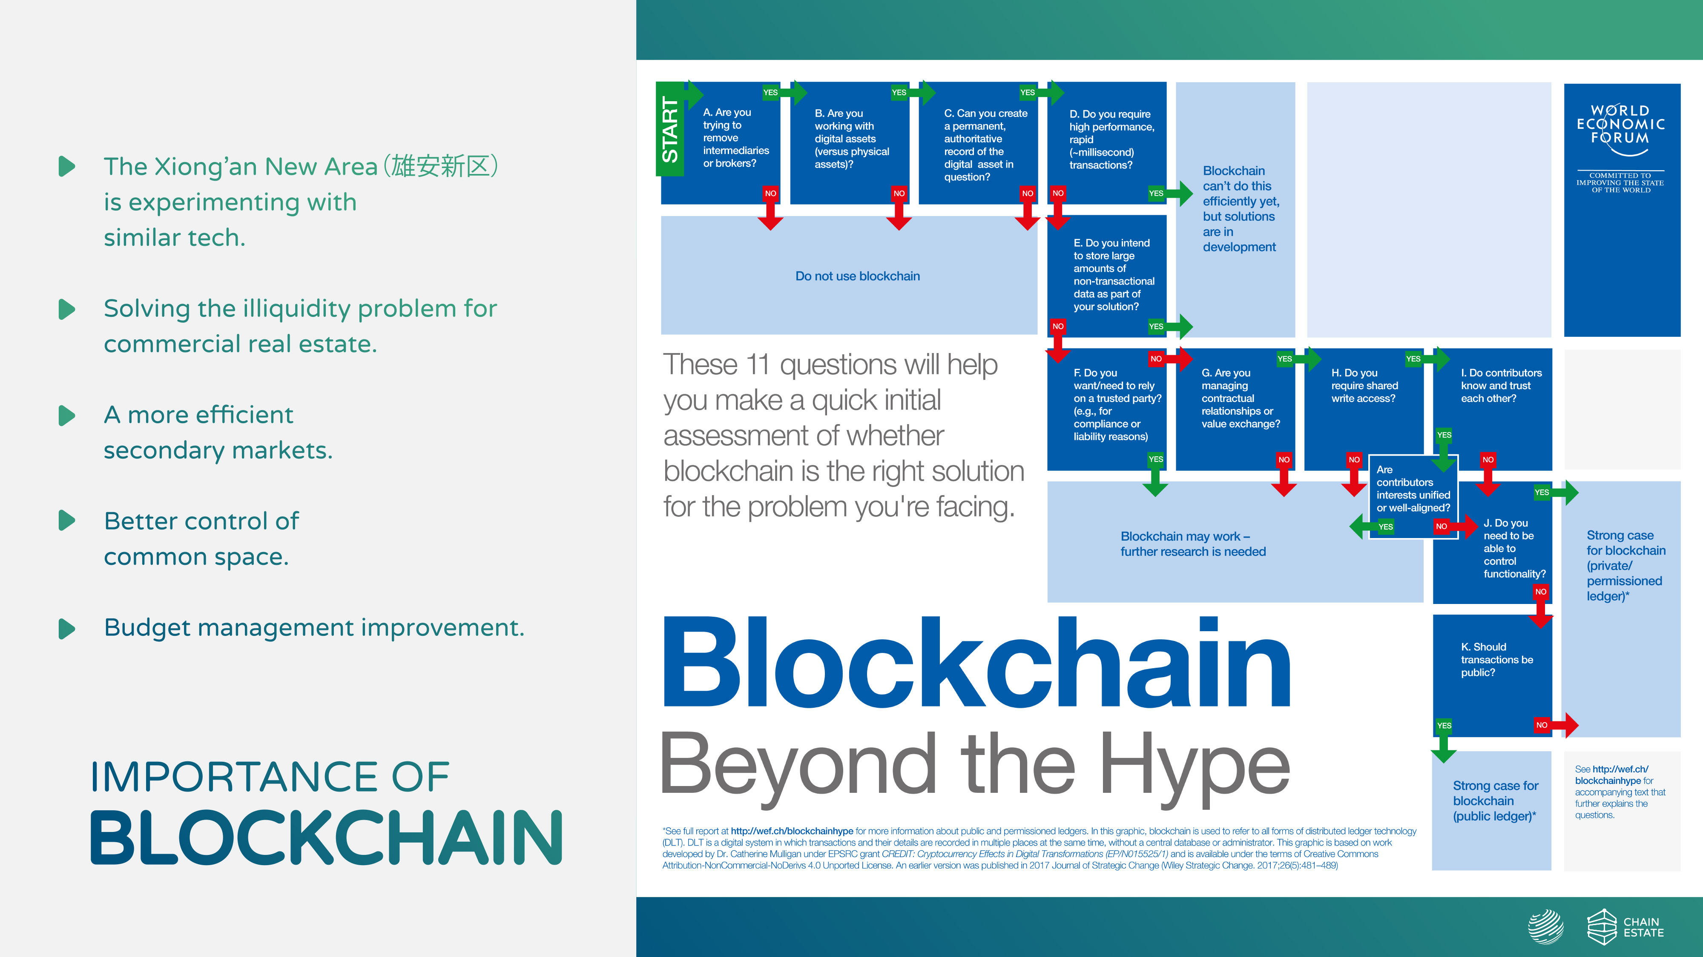


Slide 10


Slide 11



Slide 12
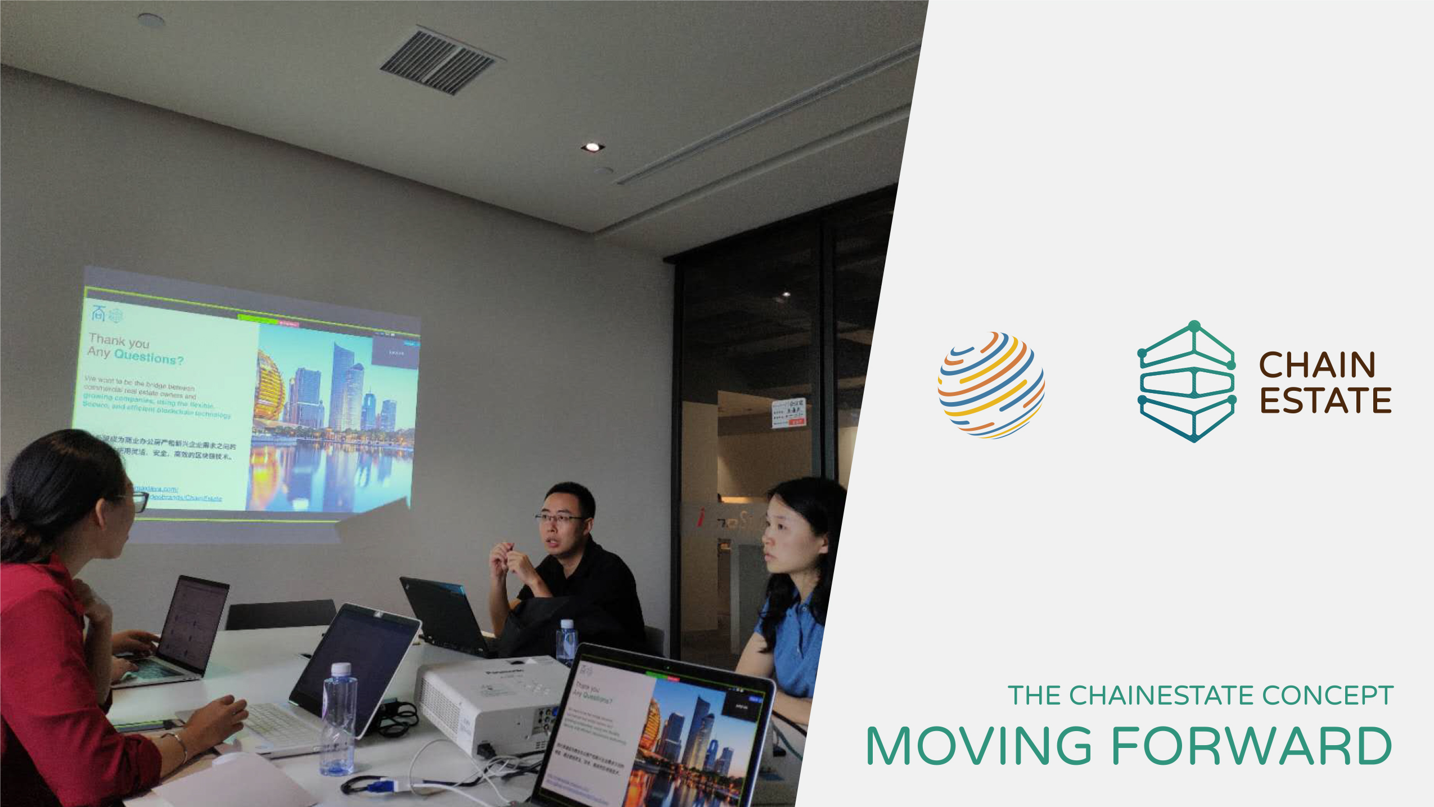

Slide 13



